Slide 1
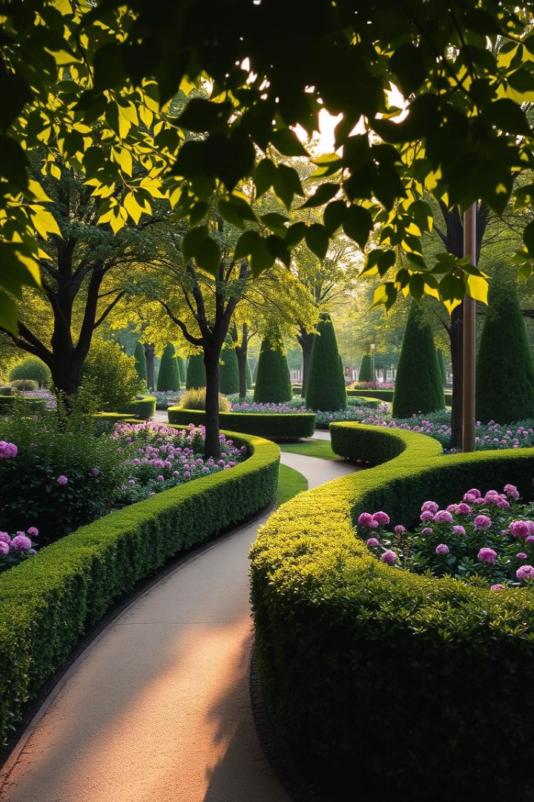
Public Garden Automation
by
Aashiq Ahmed A - urk22ra2022
Sukesan EG - urk22ra2005
Vengadesh S - urk22ra2028

Slide 2
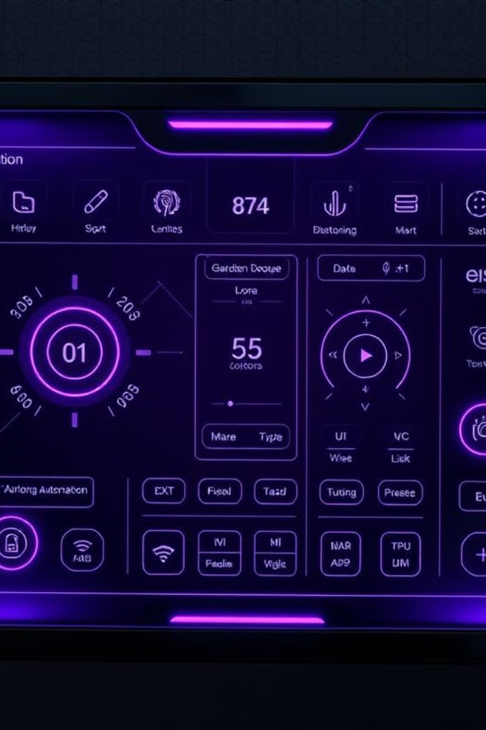
Introduction to Public Garden Automation
1
Efficient Watering
2
Responsive to Light
Automated irrigation based on real-time soil moisture data reduces water waste and ensures plants receive the right amount of hydration.
Light sensors monitor sunlight levels to control lighting, ensuring optimal conditions for plant growth.
3
Centralized Control
A single microcontroller manages the entire system, providing remote monitoring and adjustment capabilities.

Slide 3
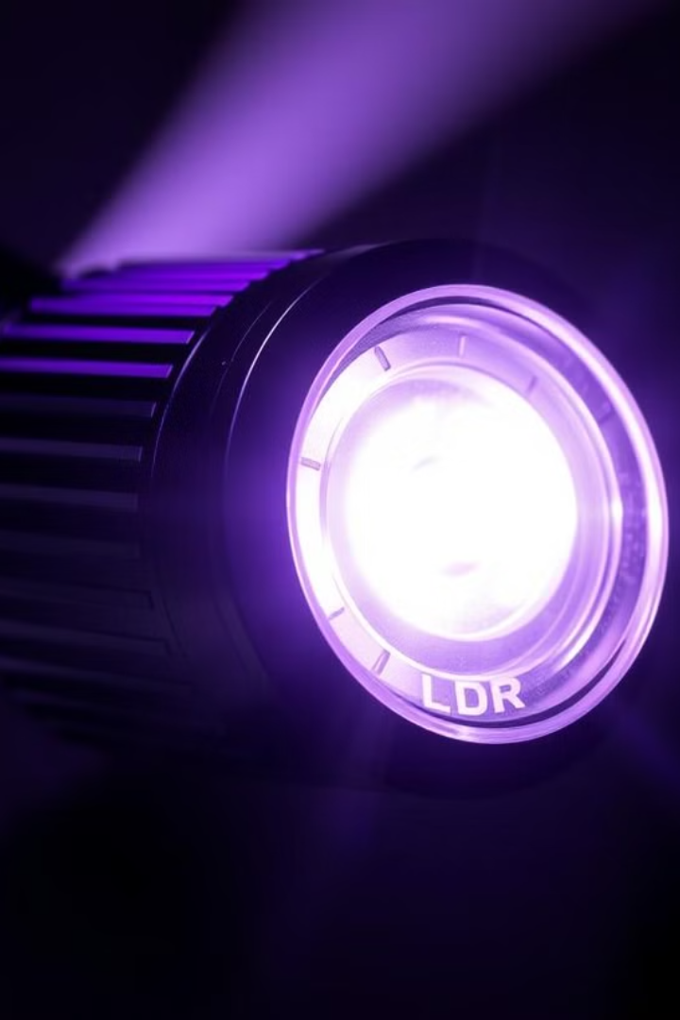



Light Dependent Resistor (LDR) for Solar Monitoring
Artificial Light Control
Energy Efficiency
Safety
By turning on artificial lights only when needed, the system conserves energy and reduces electricity costs.
The system can be used to ensure adequate light exposure for safety purposes, such as in a parking lot or a dark hallway.
The LDR sensor measures the intensity of ambient light, allowing the system to automatically turn on artificial lights when the sun sets, which can be used in a variety of situations.

Slide 4
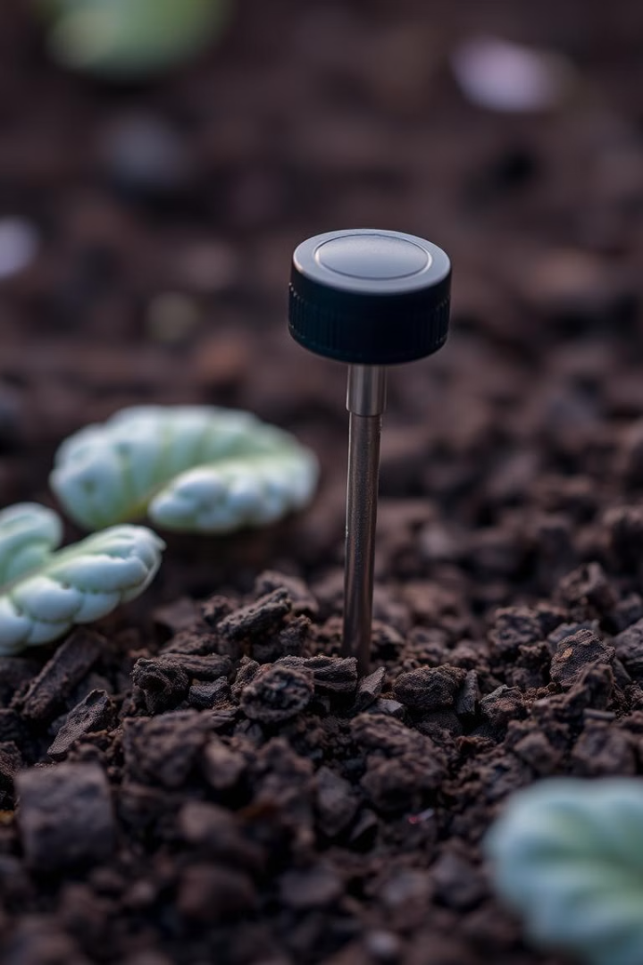
Soil Moisture Sensor for Irrigation Needs
1
Data Collection
The moisture sensor continuously measures the soil's water content, providing real-time data .
2
Decision Making
The system analyzes the moisture levels and determines when irrigation is necessary to maintain optimal soil conditions.
3
Automated Watering
The Micro controller activates the water pump to deliver the precise amount of water needed, preventing over or under-watering.

Slide 5
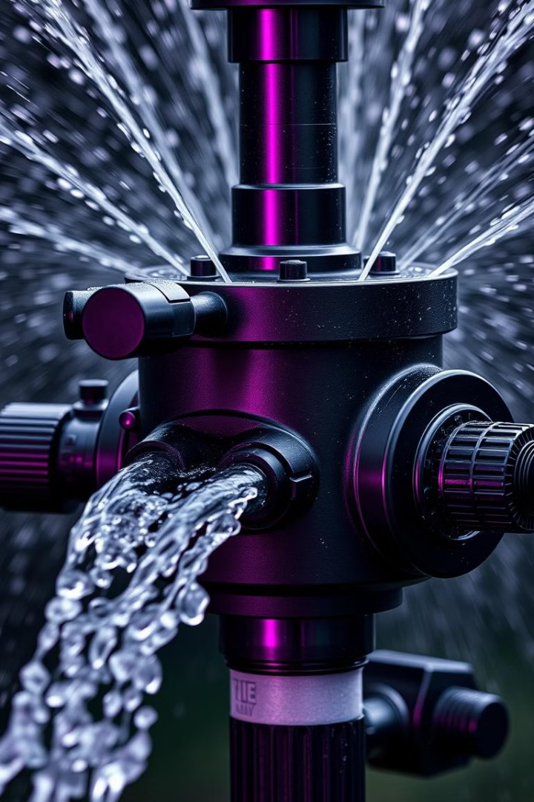
Automated Water Pump for Targeted Watering
Precision Irrigation
Water Conservation
The water pump is controlled , delivering water only to the areas that need it based on sensor data.
Targeted watering reduces overall water consumption, contributing to sustainable gardening practices.
Reduced Manual Labor
Automating the watering process eliminates the need for frequent manual intervention, freeing up time for other maintenance tasks.

Slide 6
Block Diagram
MOISTURE SENSOR
MOTOR DRIVER
RASPBERRY PI PICO
MOTOR
LDR
LIGHTS

